Slide 1
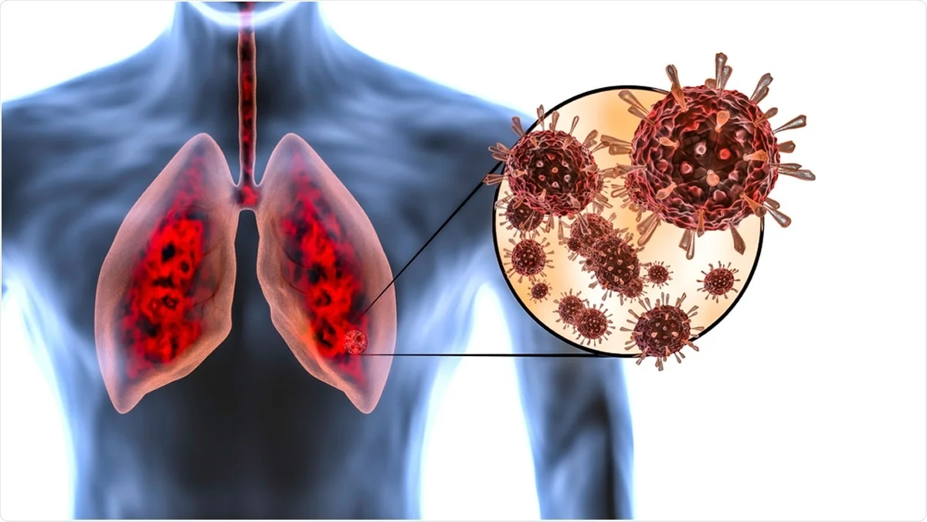
COVID-19 Update
April 17, 2021
Sean Pitman, MD

Slide 2
COVID-19 - Common misconceptions
Just another flu season
99% survival rate
A Government Bioweapon released in order to cause panic, increase Government Control, and remove Freedoms from the people
Masks and Social Distancing don’t work – more Government Control and Loss of Freedoms
The mRNA vaccines are Dangerous
Alter one’s genetic makeup
Have various poisons in them
Are experimental and untested
Cause autoimmune disorders
Are unnatural and opposed to the Adventist Health Message
Natural Remedies, and my Faith in God, are enough

Slide 3
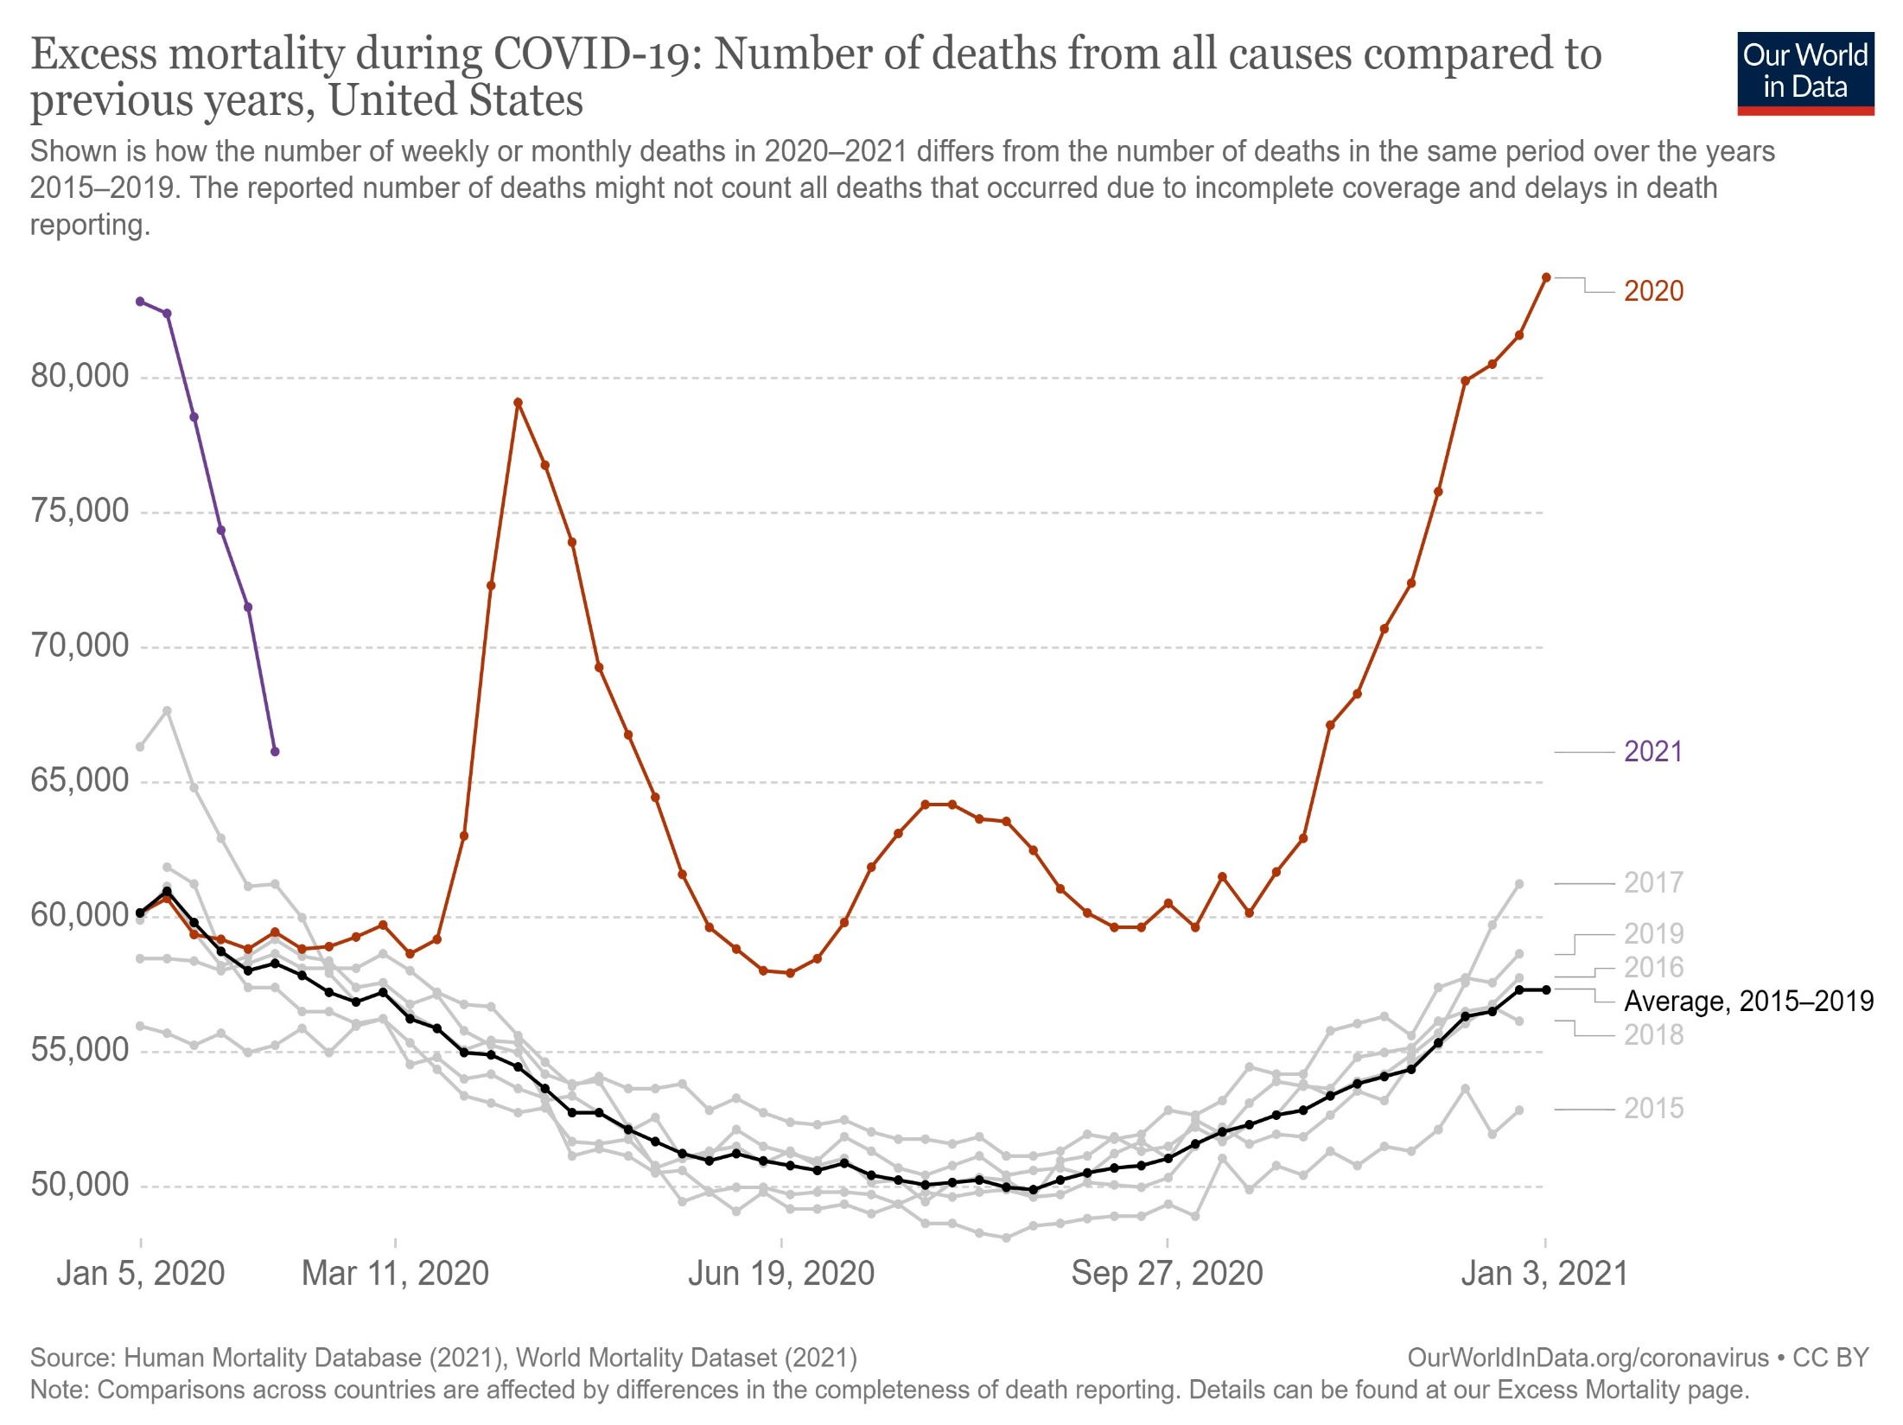
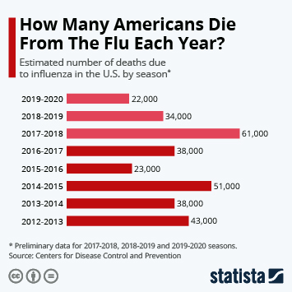
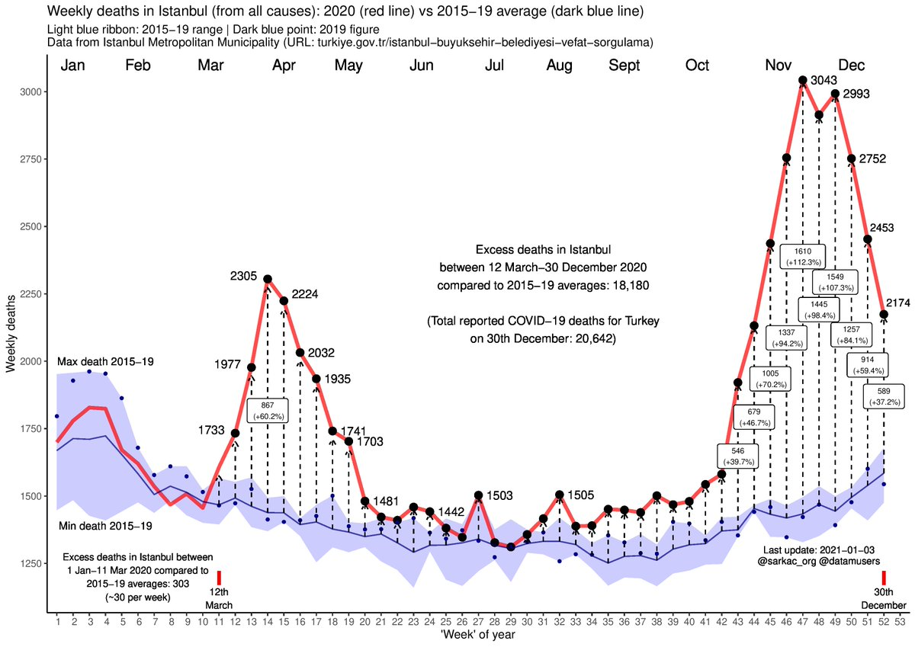
Just Another Flu Season:
Current deaths in the US: 565,000
An underestimate by as much as 30% = 735k
Doctors are overcounting cases because they are paid more for COVID-19 patients?
Only for Medicare patients (20% more)
Severe penalties for detected abuse
No pattern of overdiagnosis detected
COVID-19 deaths actually underdiagnosed based on all-cause death rate during the pandemic
Notes:
“However, there was a very pronounced seasonal variation of both influenza deaths and pneumonia deaths, the vast majority occurring during the winter. Vitamin D levels were also estimated from several publications. The data support the hypothesis that a high vitamin D level, as that found in the summer, acts in a protective manner with respect to influenza as well as pneumonia.”
https://www.ncbi.nlm.nih.gov/pmc/articles/PMC3092571/

Slide 4
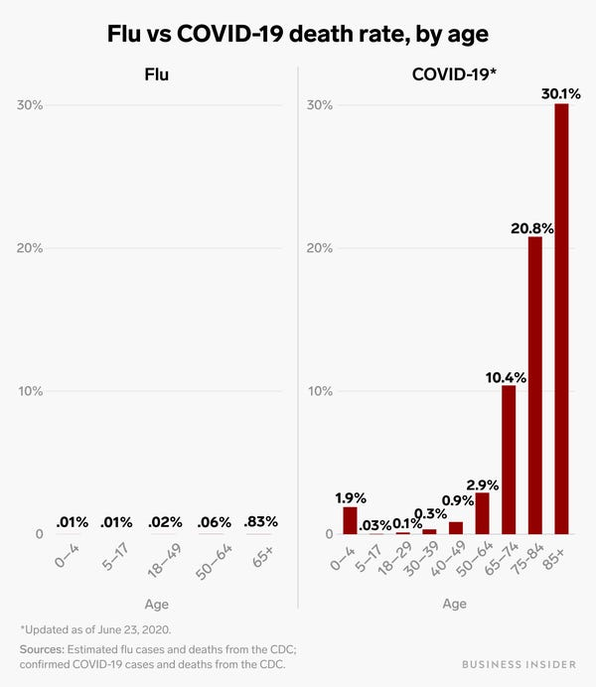
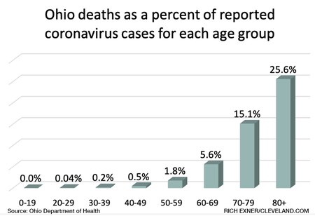
99% Survival Rate:
True, but misleading
Even if true, >3 million deaths in US Ok?

Slide 5
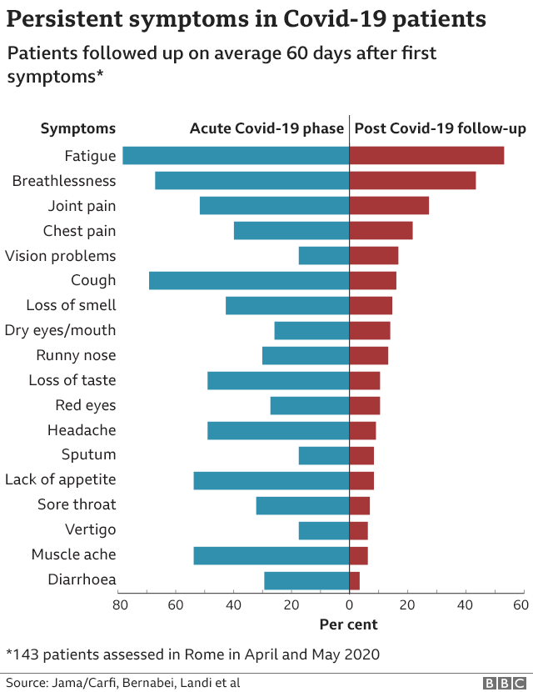
99% Survival Rate:
True, but misleading
Around 1/3 of those infected with COVID-19 develop long-term illnesses
Initial symptoms may be mild or even no symptoms
Fatigue, loss of smell or taste, strong ringing in the ears (tinnitus) and "brain fog”, etc.
1/3 experience a psychiatric or neurological illness, mostly mood disorders but also strokes or dementia
All ages affected similarly, including children. “Of the 34 children in the study, 11 were long-haulers”
Notes:
https://www.webmd.com/lung/news/20210219/a-third-of-covid-survivors-have-long-haul-symptoms#3
https://www.statnews.com/2021/04/06/1-in-3-covid19-patients-get-neuropsychiatric-diagnosis-within-six-months
https://jamanetwork.com/journals/jamanetworkopen/fullarticle/2776560
https://www.medrxiv.org/content/10.1101/2021.03.03.21252086v1
https://www.medrxiv.org/content/10.1101/2020.11.04.20226126v1

Slide 6
99% Survival Rate:
True, but misleading
Around 1/3 of those infected with COVID-19 develop long-term illnesses – i.e., “Long-Hauler’s”
“Many people who had asymptomatic Covid can also go on to develop post-acute Covid syndrome,” said Dr. Putrino. “It doesn’t always match up with severity of acute symptoms, so you can have no symptoms but still have a very aggressive immune response.”
Many start to feel better after being vaccinated
Notes:
https://www.webmd.com/lung/news/20210219/a-third-of-covid-survivors-have-long-haul-symptoms#3
https://www.statnews.com/2021/04/06/1-in-3-covid19-patients-get-neuropsychiatric-diagnosis-within-six-months
https://jamanetwork.com/journals/jamanetworkopen/fullarticle/2776560
https://www.medrxiv.org/content/10.1101/2021.03.03.21252086v1
https://www.medrxiv.org/content/10.1101/2020.11.04.20226126v1

Slide 7
99% Survival Rate:
True, but misleading
Up to 40% of COVID-19 cases are asymptomatic
Across four different studies of people with asymptomatic infections, about half have had ground glass opacities of the lungs on CT scans
Two studies have reported the same pattern in children with asymptomatic COVID-19 infections
Lung’s small blood vessels reduced in number – still asymptomatic
“I think that if you're young and you have enough lung reserve, you’ve not going to miss it because you're still able to function perfectly fine,” Dr. Marty says (professor of infectious diseases at Florida International University). “It's kind of like, you know, they say you have long hair and you cut off a 2 inches. Most people might not even notice you cut your hair because you have so much hair.”
Notes:
https://www.webmd.com/lung/news/20200811/asymptomatic-covid-silent-but-maybe-not-harmless

Slide 8
99% Survival Rate:
True, but misleading
The study looked at 100 patients (median age of just 49) who recently recovered from Covid-19, most of whom were asymptomatic or had just mild symptoms. The researchers, who performed MRI scan of their hearts an average of 2 months after they first were diagnosed with Covid-19, uncovered some concerning findings: 78% of patients had ongoing heart abnormalities and 60% had myocarditis, inflammation of the heart muscle. Even more concerning was that the extent of myocarditis was not related to the severity of the initial illness or overall course of the illness.
Puntmann, et al., JAMA, July 2020
Notes:
https://www.forbes.com/sites/robertglatter/2020/08/17/covid-19-can-cause-heart-damageeven-if-you-are-asymptomatic/?sh=69e608006cef

Slide 9
Government Bioweapon to Control & x-Freedoms:
Bioweapon? True, but not manmade…
‘Sir, didn’t you sow good seed in your field? Where then did the weeds come from?’ ‘An enemy did this,’ he replied. – Matthew 13:27-28
Ellen White advised: “Our work is not to make a raid on the Government but to prepare a people to stand in the great day of the Lord. The fewer attacks we make on authorities and powers, the more work will we do for God.... Do all in your power to reflect the light, but do not speak words that will irritate or provoke” (EV, 173).
Teach the people to conform in all things to the laws of their state when they can do so without conflicting with the law of God. (Testimonies for the Church 9:238)

Slide 10
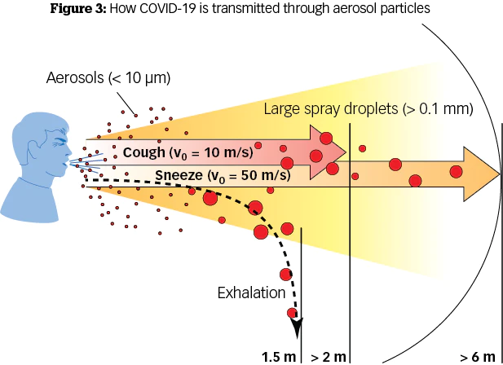
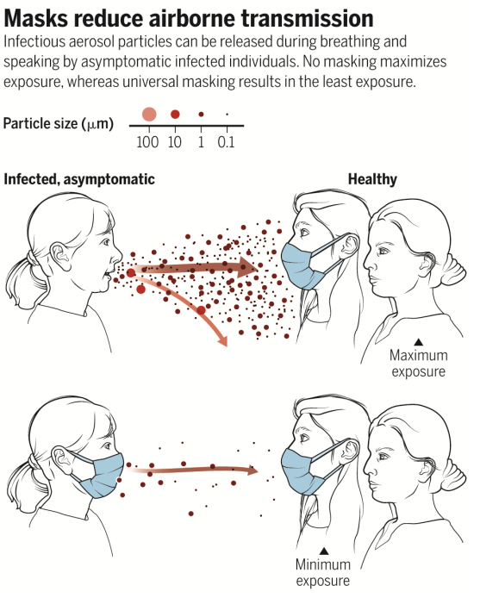
Masks and Social Distancing Don’t Work?
While not 100%, they do help to reduce the spread of infection
Masks do not reduce O2 saturation or increase the bodies CO2 for the vast majority of people
One way to demonstrate concern for one’s neighbor rather than to view it as a restriction of personal freedoms
I personally would still wear a mask in public places even if I knew, 100%, that I could neither catch or transmit the COVID-19 virus… until herd immunity is reached

Slide 11
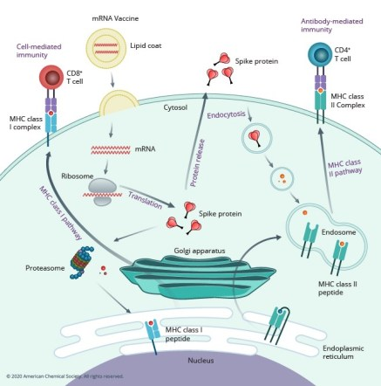
The mRNA Vaccines are Dangerous:
Alter one’s genetic makeup?
mRNA does not make it into the nucleus of the cell and does not change or alter one’s DNA in any way
mRNA is like a temporary sticky note that is read a few times and then goes away in a few days…

Slide 12
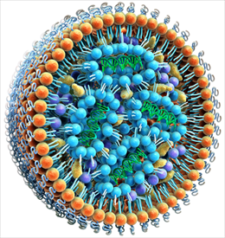
The mRNA Vaccines are Dangerous?
Have various poisons in them?
The mRNA vaccines contain mRNA, some salts, a sugar, and some lipids
They do not contain any “toxins” or “adjuvants” such as mercury, aluminum, formaldehyde, etc.
They do not contain cellular tissue or proteins of any kind and do not require cellular cultures, like those derived from human fetal cell lines, to produce
Those with a history of severe allergies, like to peanuts, may have an allergic reaction to the lipids in the mRNA vaccines (PEG)
Notes:
mRNA, lipids ((4-hydroxybutyl)azanediyl)bis(hexane-6,1-diyl)bis(2-hexyldecanoate), 2 [(polyethylene glycol)-2000]-N,N-ditetradecylacetamide, 1,2-Distearoyl-sn-glycero-3- phosphocholine, and cholesterol), potassium chloride, monobasic potassium phosphate, sodium chloride, dibasic sodium phosphate dihydrate, and sucrose.
https://www.fda.gov/media/144414/download

Slide 13
The mRNA Vaccines are Dangerous?
Are experimental and untested? FDA Approved?
Double-blinded randomized-controlled trials on both animals and 70,000 humans showing excellent safety and efficacy of >95% (EUA by FDA)
Have been studied now for over 30 years
Mechanism of action very well known
Still very safe and very effective in hundreds of millions of vaccines given worldwide
Israel = 5 million and US = 80 million fully vaccinated
1/1,000 chance of contracting the disease (0.1%)
Of those who do get sick, 1% hospitalized (0.001%)
Of those hospitalized, 10% will die (0.0001%)
0.0001% death rate for those vaccinated = 1 in 1 million
More than 1.7 in 1000 Americans have died of COVID-19 so far in the US alone
Notes:
https://www.haaretz.com/israel-news/israel-vaccine-data-how-many-have-already-been-inoculated-for-covid-1.9626604
https://www.ocregister.com/2021/04/15/cdc-reports-5800-covid-19-infections-74-deaths-in-fully-vaccinated-people/

Slide 14
mRNA Vaccines (Pfizer and Moderna) Dangerous?
Cause autoimmune disorders?
Possible, but very rare – much lower rates than getting infected by the live COVID-19 virus
Risk of ITP for mRNA vaccine: ~1 in 1 million
Risk of ITP for COVID-19: 40-50 x higher
DNA Vaccines (J&J and AstraZeneca) show a rare increase in blood clots (~1 in 1 million with 1 death out of 6 cases of CVST for J&J – all young women)
Possibly due to the viral vector used (adenovirus shell) cross-reacting with PF-4 (usually in young women)
Blood clots in 1/2000 women taking oral contraceptives
Blood clots in 1/1000 people who travel by plane
1/10 with COVID-19 will have blood clots (DVT, PE, etc…)
1/3 with COVID-19 will get ITP
1 in 700,000 of being struck by lightening per year
CVST = Cerebrovascular Sinus Thrombosis
Notes:
https://www.ncbi.nlm.nih.gov/pmc/articles/PMC7501509/
https://www.prnewswire.com/news-releases/joint-cdc-and-fda-statement-on-johnson--johnson-covid-19-vaccine-301267526.html (April 13, 2021) – 6 cases of Cerebrovascular Sinus Thrombosis
https://www.cdc.gov/disasters/lightning/victimdata.html
https://www.nationalgeographic.com/science/article/flash-facts-about-lightning

Slide 15
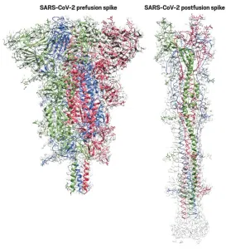
The mRNA Vaccines are Dangerous?
Antibody-Dependent Enhancement (ADE)
Well-known complications of vaccines, but, again, much more commonly associated with viral infections
mRNA vaccines carefully crafted specifically to avoid ADE – apparently successfully
Notes:
https://www.ncbi.nlm.nih.gov/pmc/articles/PMC7501509/
http://www.educatetruth.com/featured/are-mrna-vaccines-for-covid-19-helpful-or-harmful/#Do-mRNA-vaccines-increase-the-risk-of-autoimmunity

Slide 16
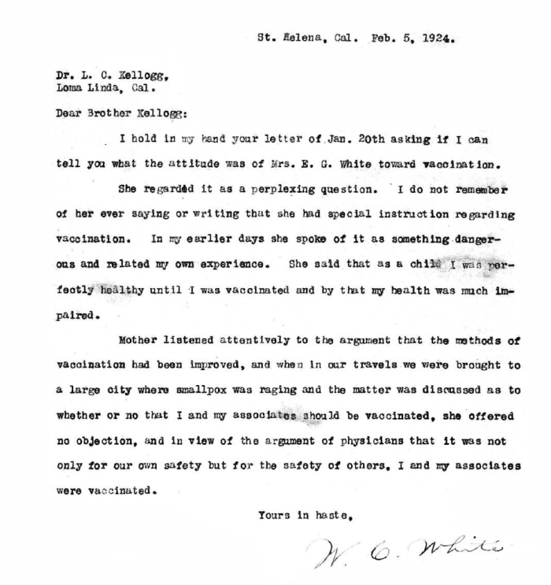
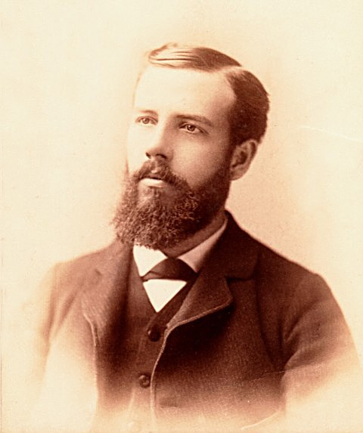
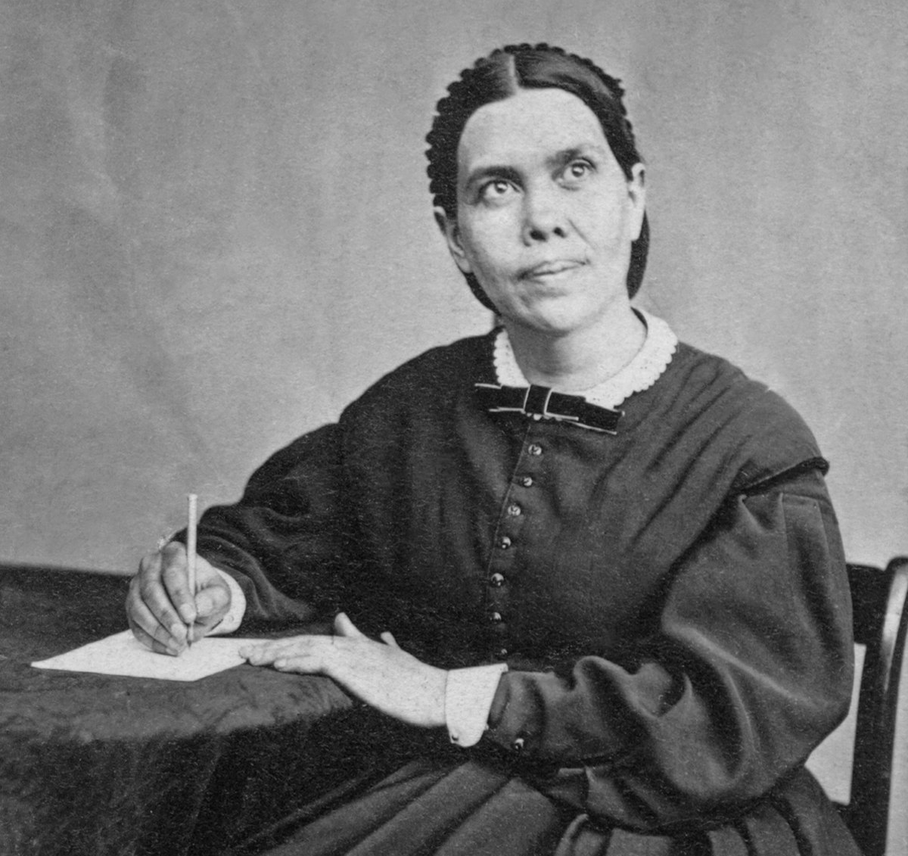
The mRNA Vaccines are Dangerous:
Are unnatural and opposed to the Adventist Health Message?
Any more unnatural than getting infected by a foreign invader designed by the Devil himself?
Ellen White’s son, William White, was vaccinated for smallpox with his mother’s knowledge and approval – despite having a bad childhood experience with a vaccine

Slide 17
The mRNA Vaccines are Dangerous:
Are unnatural and opposed to the Adventist Health Message?
Any more unnatural than getting infected by a foreign invader designed by the Devil himself?
Ellen White’s son, William White, was vaccinated for smallpox with his mother’s knowledge and approval – despite having a bad childhood experience with a vaccine
Ellen White’s personal secretary for over 13 years, D. E. Robinson, and married to her granddaughter Ella, said that Ellen White was herself vaccinated for smallpox and recommended this vaccine to her staff and family
Recommended drugs like quinine to fight malaria, anesthesia during surgery, blood transfusions, pain relievers for intense pain, radiation therapy… etc

Slide 18
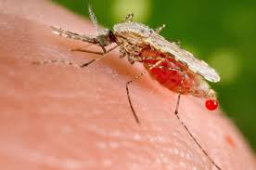
“Would I have sinned to give the boy quinine when I knew of no other way to check malaria and when the prospect was that he would die without it?” In reply she said, “No, we are expected to do the best we can.”
—W. C. White letter, September 10, 1935.—Compilers—Counsels on Health, 261 (1890).
Elsewhere she wrote, “If quinine will save a life, use quinine.”
Selected Messages, (Washington, D.C.: Review and Herald Pub. Assn., 1958), 2: 282 (footnote); S.P.S. Edwards to F.D. Nichol, November 24, 1957, Question and Answer File 34-B-2, EGWE.
Notes:
Quinine is used for its toxicity to the malarial pathogen, Plasmodium falciparum, by interfering with the parasite's ability to dissolve and metabolize hemoglobin. As with other quinoline antimalarial drugs, the precise mechanism of action of quinine has not been fully resolved, although in vitro studies indicate it inhibits nucleic acid and protein synthesis, and inhibits glycolysis in P. falciparum. The most widely accepted hypothesis of its action is based on the well-studied and closely related quinoline drug, chloroquine. This model involves the inhibition of hemozoin biocrystallization in the heme detoxification pathway, which facilitates the aggregation of cytotoxic heme. Free cytotoxic heme accumulates in the parasites, causing their deaths. Quinine may target the malaria purine nucleoside phosphorylase enzyme.
https://en.wikipedia.org/wiki/Quinine#Mechanism_of_action

Slide 19
Natural Remedies are Enough:
Vitamin D, sleep, hot/cold hydrotherapy, quercetin with zinc, magnesium, NAC, vitamin C, forest bathing, exercise, overall physical fitness, etc… all great for the innate immune system, but don’t help the adaptive immune system
mRNA vaccines still helpful for educating the Adaptive Immune System for the best overall chance at fighting off the COVID-19 virus without significant damage to the body
Short answer: Do it all
God will Save me, so no need to fear…

Slide 20
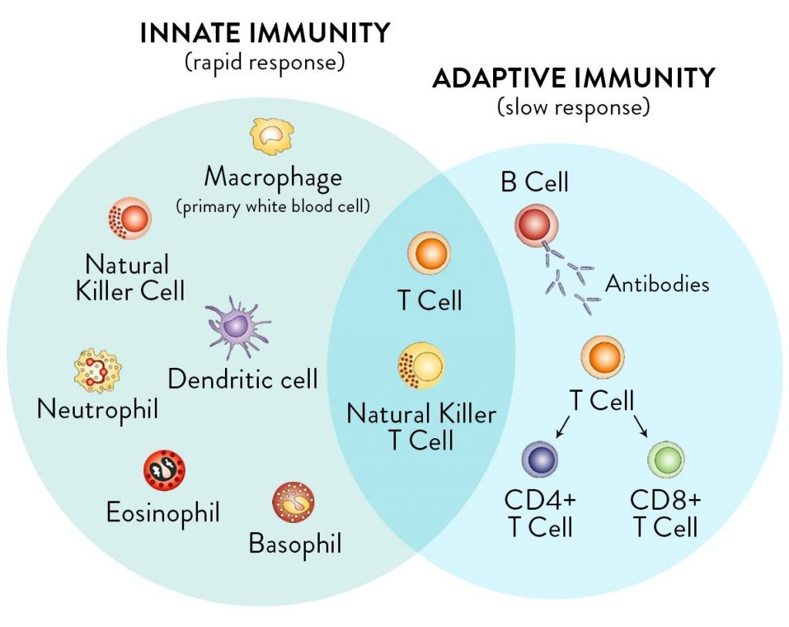

Slide 21
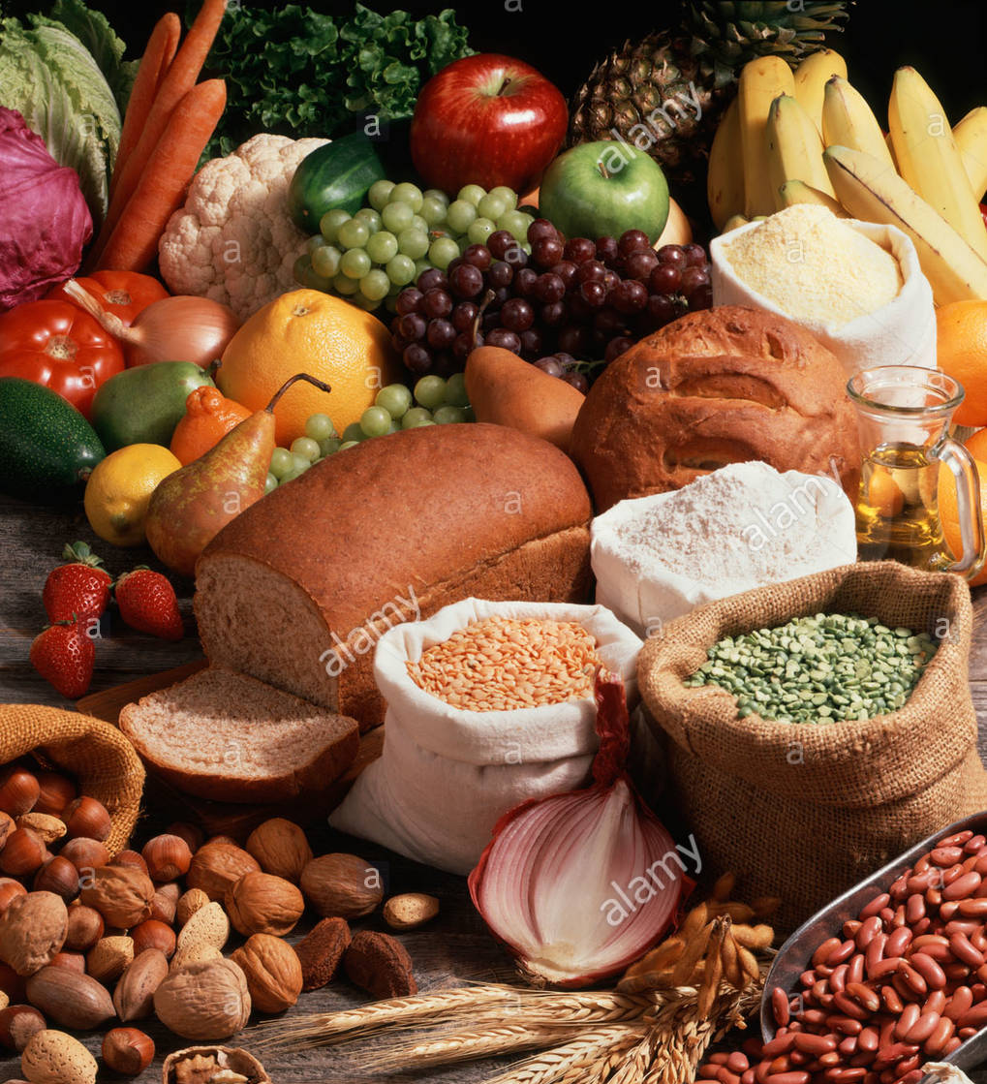
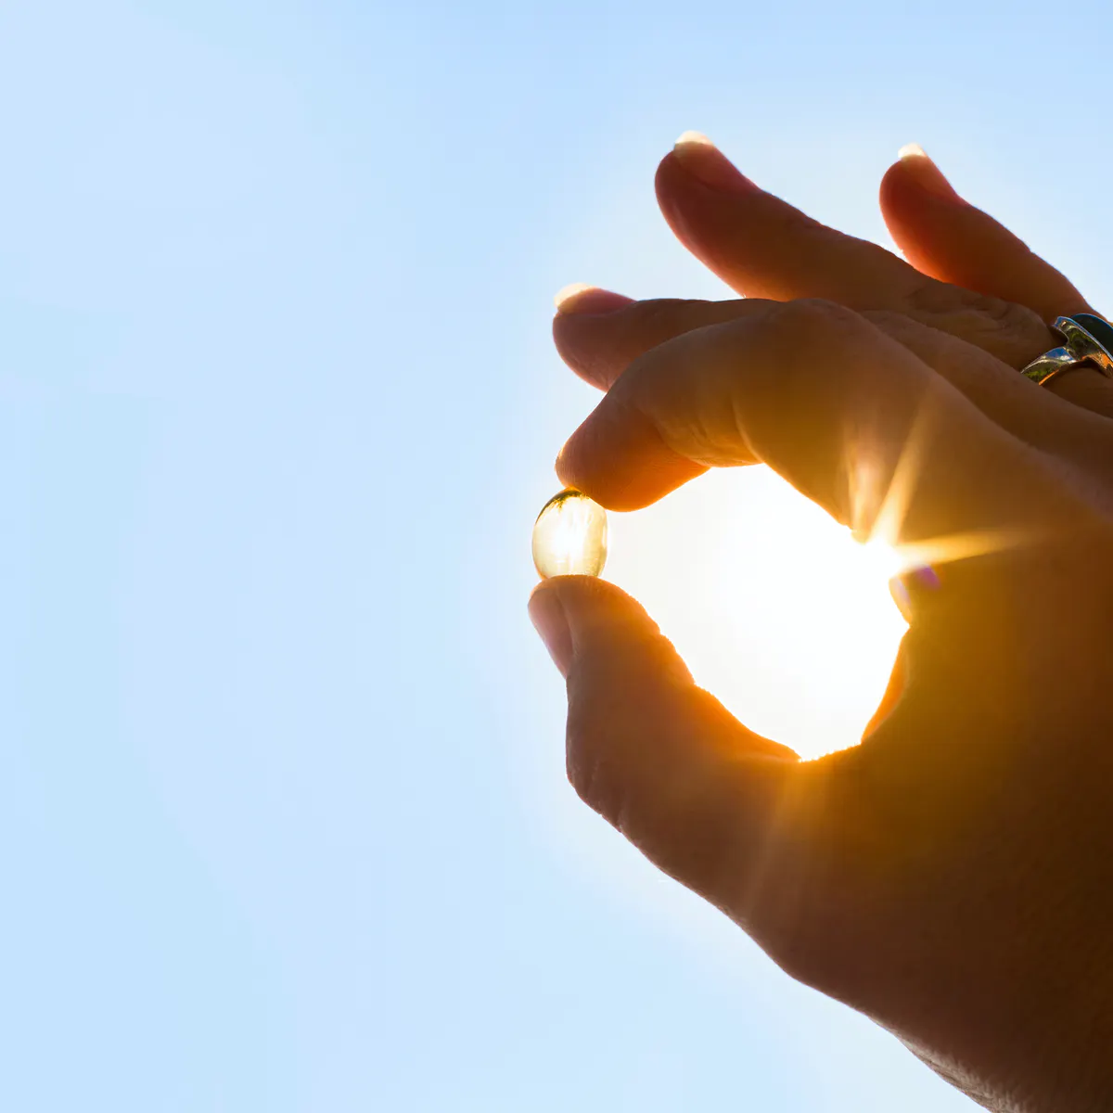
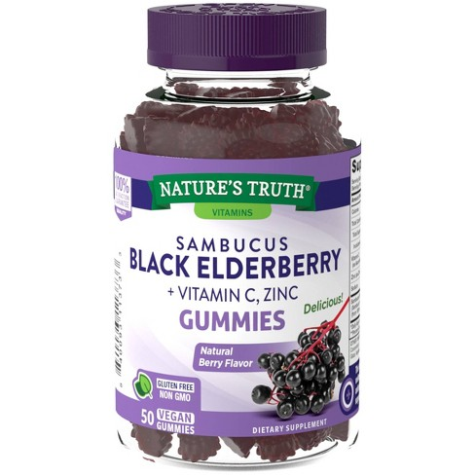
COVID-19 Recommendations
Sean D. Pitman, M.D.
www.DetectingDesign.com

Slide 22
Vitamin D: Blood Level > 50 - 60 ng/mL
For most people, 4-10k Units/Day (125-250 mcg/day)
Studies show that Vitamin D can reduce COVID-19 deaths by up to 60%! - and 80% less likely to require ICU treatment!
Zinc: 15-30 mg/day
Quercetin: 500 mg/day
Magnesium: 350 mg/day
n-acetylcysteine (NAC): 600 mg/day
Hot/Cold showers: 5 or 6 cycles per day
Sleep: 8 hours/day
Forest Bathing: Increase in NK cells up to 7 days – even some effect up to 30 days
Notes:
Xavier Nogués, et. al., Calcifediol Treatment and COVID-19-Related Outcomes (pre-print, Lancet, Jan 21, 2021)
https://papers.ssrn.com/sol3/papers.cfm?abstract_id=3771318
“A total of 930 participants were included. Participants (n=551) were randomly assigned to calcifediol treatment (532 ug on day one and 266 ug on day 3, 7, 15, and 30) at the time of hospital admission… Higher baseline 25(OH)D levels were significantly associated with decreased mortality (RR 0.40 [95% CI 0.24;0.67]).”
Forest Bathing with Dr. Roger Seheult: https://youtu.be/PgDjVEpEOdQ

Slide 23
Dr. Roger Seheult – an LLU trained Doctor of Internal Medicine, triple boarded, with specialties in pulmonology, critical care and sleep medicine:
MedCram.com

