Slide 1
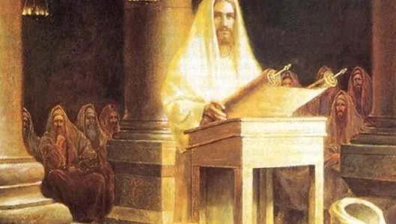
Christians and the Sabbath
Sean Pitman
May 6th, 2017
Notes:
Personal family and friends leaving the church over the Sabbath…
What seems to me to be a Misunderstanding of the true gift of the Sabbath, it’s biblical basis, and history in the Christian Church.

Slide 2
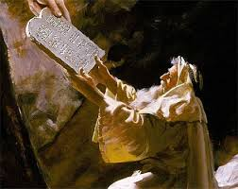
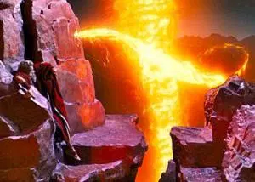
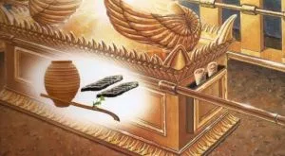
Why continue to keep the Sabbath?
One of the Ten Commandments (Exodus 20:8-11)
Written by God’s own finger
Written in stone
Placed inside the Ark of the Covenant
Notes:
One person actually told me that the Ark of the Covenant was made too small to hold the rest of the laws of Moses – which is why they were put on the outside in a box.

Slide 3
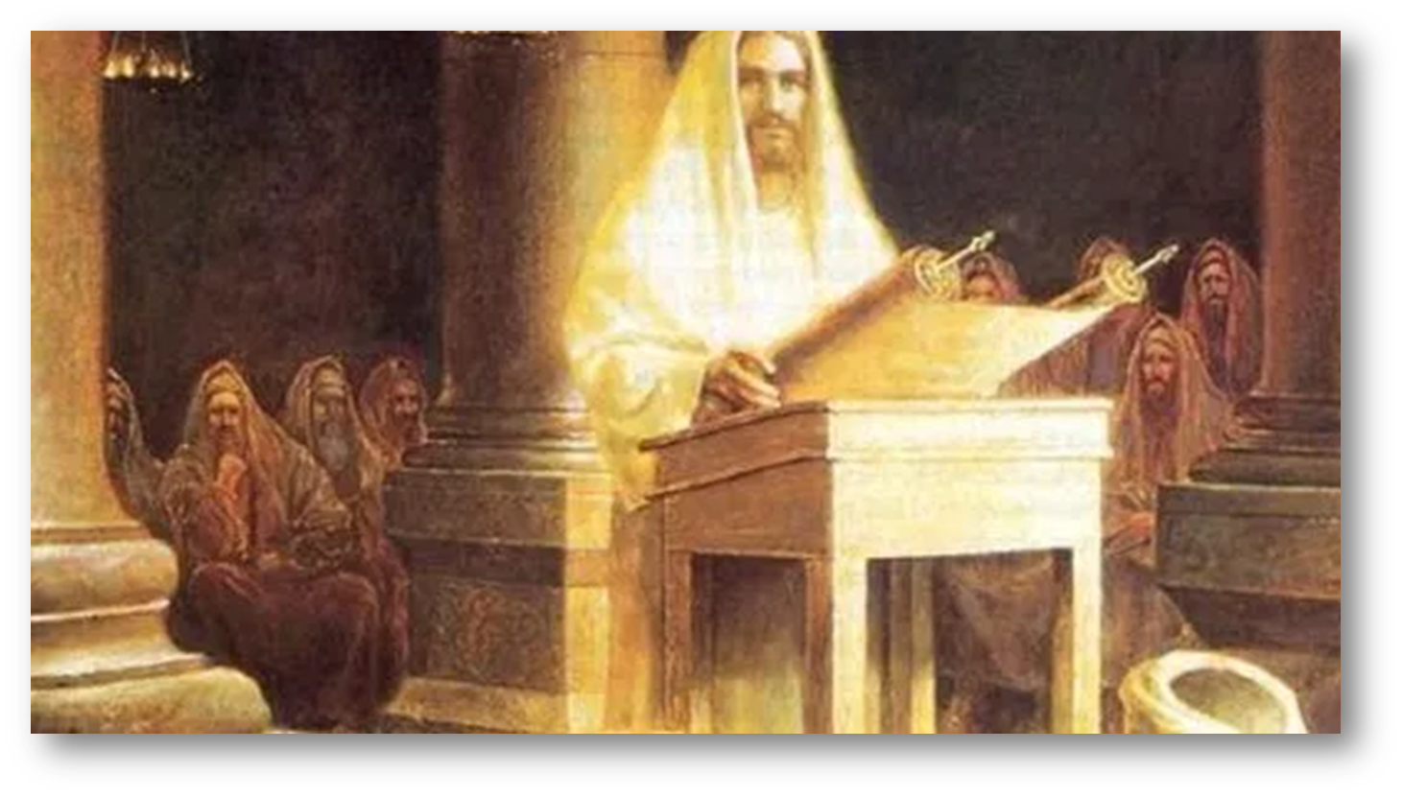
Jesus and disciples kept the Sabbath:
Rested in the tomb on the Sabbath and His disciples also rested “in obedience to the commandment” (Luke 4:16)
It was His custom to worship in the synagogue on the Sabbath day (Luke 4:16).

Slide 4
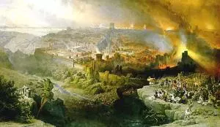
Future Christians to keep the Sabbath:
Jesus said that His followers should pray that their future flight from the Roman armies, armies that would destroy Jerusalem (some 40 years later in 70 AD), “not take place in the winter or on the Sabbath day” (Matthew 24:20).
Notes:
Christians to be keeping the Sabbath in the future:

Slide 5
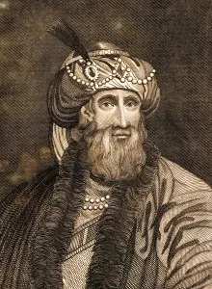
Josephus (37-100 AD)
Notes:
The usual counter to this argument is that Jesus said this for practical reasons, not because His disciples would be keeping the Sabbath as a holy day, but so that they could more effectively flee if their flight were not on a Sabbath day (given that the gates of the cities would be closed on the Sabbath).
The problem with this argument, however, is that, according to Josephus, everything was left wide open for the Christians to flee from Jerusalem. Even the gates of the temple itself were miraculously opened as a sign of God’s departure (Link). Also, the Roman armies initially retreated and the Jewish soldiers chased after them – leaving the city and the countryside undefended and wide open for the Christians to escape (Link). Numerous historians have commented on this miraculous situation…

Slide 6
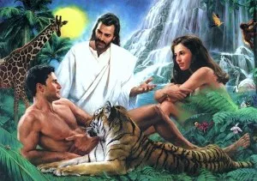
Sabbath made in Eden before Fall
Notes:
At the end of the creation week described in Genesis, “God blessed the seventh day and made it holy, because on it he rested from all the work of creating that he had done.” (Genesis 2:3)
It seems, then, that Jesus originally created the Sabbath day as a special social day of rest from the usual activities of life to have an entire day to spend with especially with God. This was a gift from God for all of humankind – originally given back in Eden before sin had even entered the world. Why then would such a gift be discarded by the Christian?

Slide 7
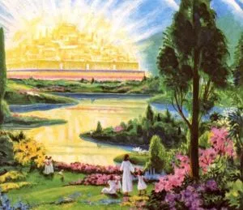
Sabbath to be kept in the New Earth:
“As the new heavens and new earth that I make will endure before me,” declares the LORD, “so will your name and descendants endure. From one New Moon to another and from one Sabbath to another, all mankind will come and bow down before me,” says the LORD. (Isaiah 66:22-23)

Slide 8
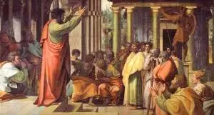
Sabbath kept after Jesus:
John’s phrase “I was in the Spirit on the Lord’s Day” = Sabbath (Revelation 1:10). Only the Sabbath had ever been referred to as “the Lord’s Day” by that time (Mark 2:28 and Isaiah 58:13).
Christians continued to worship in the temple and synagogues, as they had always done (Acts 3:1). No significant changes to their customs of worship are described in the Bible.
No dispute between the Christians and the Jews about the Sabbath day is very good evidence that early Christians still observed the same day that the Jews.
Paul led at least eighty-four worship services on the Sabbath.
- Acts 13:14, 44; 16:13; 17:2; 18:4-11
“Custom” to worship on Sabbath
- Acts 17:2

Slide 9
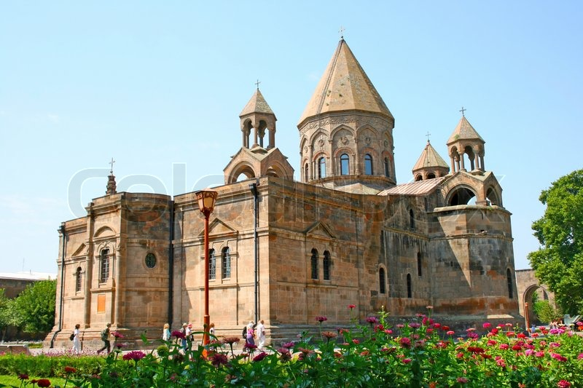
Early Christian Church kept the Sabbath:

Slide 10
Historical Snapshot:
1st Century: Sabbath with gradual Sunday observance
2nd Century: Hadrian outlaws Judaism and Sabbath
2nd – 3rd Centuries: Christian leaders start to spiritualize the Sabbath; favor Sunday observance
4th Century: Constantine makes Christianity state religion; issues 1st of many state Sunday Laws
5th Century: Sabbath makes a comeback worldwide
6th-11th Centuries: Conflicts between East and West
11th Century: Great Schism between East and West
11th-16th Centuries: Sabbath kept in Ireland, Scotland, Wales, India, China, Persia, Kurdistan, Ethiopia…
100+ modern languages: 7th-day called “Sabbath”

Slide 11
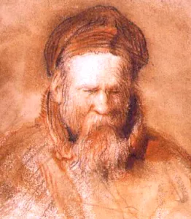
The seventh day is the completion of creation, “for it is the festival, not of a single city or country, but of the universe, and it alone strictly deserves to be called ‘public’ as belonging to all people and the birthday of the world.”
Philo of Alexandria (20 BC – 50 AD):
Notes:
Lived at the same time as Jesus…

Slide 12
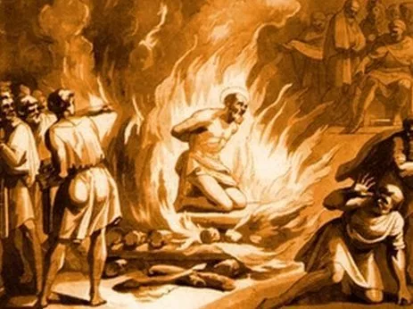
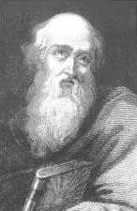
Arrested on the “Day of Preparation” and martyred on the “Great Sabbath” – the Sabbath before the Passover
Was a Nazarene – and Nazarenes observed the Sabbath
Disciple of John
Polycarp (69-155 AD)

Slide 13
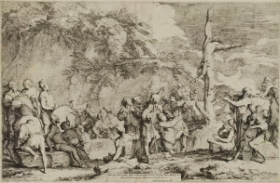
Polycrates taught the true Gospel of the literal establishment of the Kingdom of God on earth, the unconscious state of the dead awaiting the resurrection, and the importance of keeping God’s Law, the Ten Commandments – and was eventually crucified like Jesus.
A Disciple of Polycarp
Polycrates of Ephesus (125-196 AD):

Slide 14
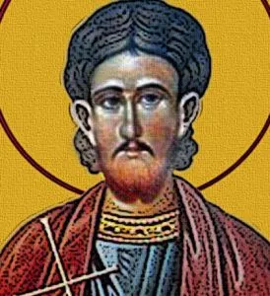
And on the sixth day God finished His works which He made, and rested on the seventh day from all His works which He made. And God blessed the seventh day, and sanctified it; because in it He rested from all His works which God began to create…
Theophilus compares those who “keep the law and commandments of God” to the “fixed stars”, while the “wandering stars” are “a type of the men who have who wandered from God, abandoning his law and commandments.”
He upheld Decalogue, including the Sabbath. He didn’t write one word concerning the observance of Sunday as a holy day – though it was already popular.
Theophilus, Bishop of Antioch (120-190 AD):

Slide 15
Historians on Sabbath Observance by Early Christians:

Slide 16
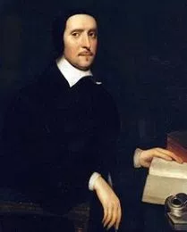
“The primitive Christians did keep the Sabbath of the Jews… till the time of the Laodicean council.”
Jeremy Taylor (1613-1667):

Slide 17
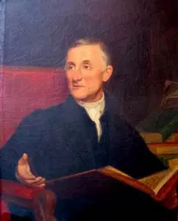
“The practice of it [the keeping of the Sabbath] was continued by Christians who were jealous for the honor of the Mosaic law, and finally became, as we have seen, predominant throughout Christendom. It was supposed at length that the fourth commandment did require the observance of the seventh-day Sabbath (not merely a seventh part of time). And reasoning as Christians of the present day are wont to do, that all which belonged to the ten commandments was immutable and perpetual, the churches in general came gradually to regard the seventh day Sabbath as altogether sacred.”
Moses B. Stuart (1780-1852):
Notes:
Moses B. Stuart (1780-1852):
Professor Stewart, in speaking of the history of the Christian Church during the period from Emperor Constantine to the Council of Laodicea, says:
So, after Constantine’s time, there seems to have been in a measure a revival of interest in, and reverence for, the Sabbath in the minds of most Christians throughout the Christian world – especially in the Eastern churches, where the influence of the Western Roman Church was less powerful.

Slide 18
Early Attempts to Remove the Sabbath from Christianity:

Slide 19
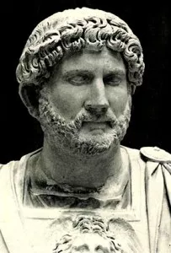
Under Emperor Hadrian, the practice of the Jewish religion and particularly Sabbathkeeping were outlawed (around 135 AD).
Notes:
Hadrian (76-138 AD):
Jerusalem was completely destroyed and then rebuilt as a Roman city with Roman temples. Jews were barred from even entering this city – while Christians were still allowed to enter.

Slide 20
The response of the Church?
Common arguments:
Every day is the Lord’s – every day is a Sabbath rest in Christ
Jesus fulfilled the Law for us so that we find our 8th-day or eternal rest in Him
First time Sunday is referred to as “The Lord’s Day”
During the 2nd and 3rd centuries various prominent Christian leaders (primarily in Rome and Alexandria), promoted being busy doing “divine work” on the Sabbath and allegorizing the meaning of the Sabbath to lessen its status as compared to Sunday or “The Lord’s Day”…
Justin Martyr (100-165 AD), Irenaeus (130-202 AD), Pothinus (87-177 AD), Tertullian (160-220 AD), Clement (150-215 AD), and Origen (185-254 AD).

Slide 21
Sabbath vs. Sunday

Slide 22
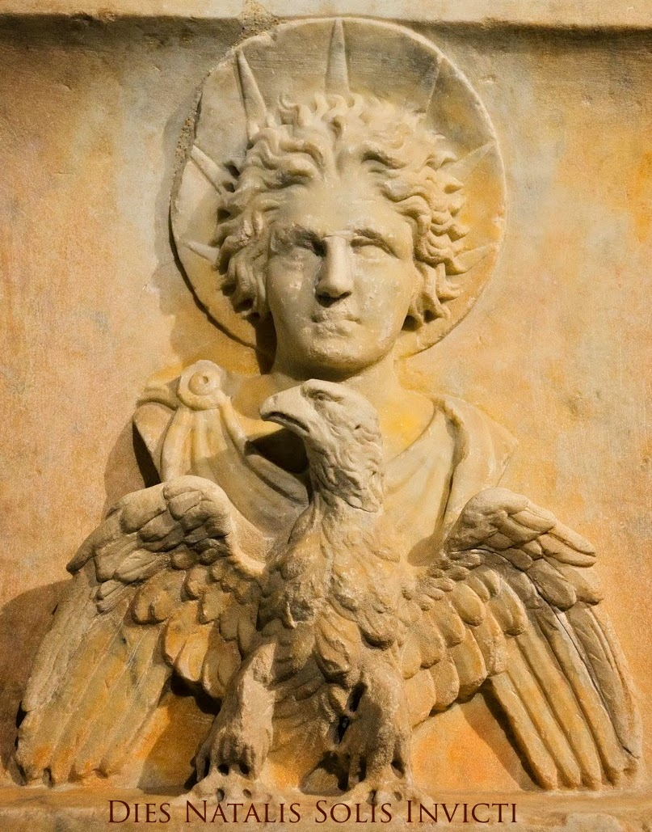
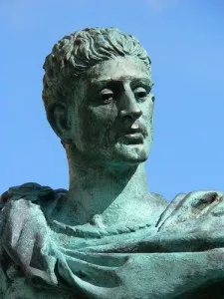
These laws restricted what could be done on Sunday and forbade Sabbath keeping. Each law became more and more strict, each penalty more and more severe.
This is strong evidence of the continued desire by many Christians, throughout the Christian world, to continue to keep the 4th Commandment of the Decalogue of God.
Constantine enacted several Sunday laws during his reign (306-337 A.D.) followed by at least fifteen additional Sunday decrees within the next few centuries after his death …
In the centuries following Emperor Constantine, there was a significant revival in Sabbath observance within the majority of Christian Churches throughout Christendom.
The Sun God, Sol Invictus, was already popular in the Roman Army and was worshiped on Sunday
Sunday, “The Venerable day of the Sun” made State “Day of Rest” in 321 AD – except for farmers
Constantine made Christianity the State Religion
Sabbath sacredness had been reduced
Sunday observance had, by this time, become popular; for Christians and Pagans
Emperor Constantine (274-337 AD):

Slide 23
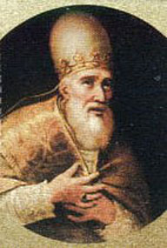
Pope Sylvester (314-335) was the first to order the churches to fast on Saturday, and Pope Innocent (402-417) did the same (in order to bring the Sabbath into disfavor)
Notes:
Why repeated orders to fast on the Sabbath if Sabbath observance wasn’t a problem for the Catholic Church during this time?

Slide 24
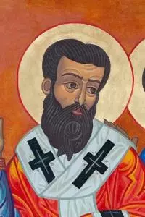
“With what eyes can you behold the Lord’s day, when you despise the Sabbath? Do you not perceive that they are sisters, and that in slighting the one, you affront the other?”
Gregory of Nyssa (335-394):
Notes:
Gregory of Nyssa (335-394):
Bishop of Nyssa
Venerated as a saint in Roman Catholicism, Eastern Orthodoxy, Oriental Orthodoxy, Lutheranism, and Anglicanism.
Yet, even during this time, following the decrees of Constantine, Gregory wrote about the equality of the Sabbath day with the “Lord’s Day”, or Sunday worship:

Slide 25
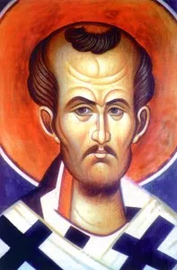
“There are many among us now, who fast on the same day as the Jews, and keep the sabbaths in the same manner; and we endure it nobly or rather ignobly and basely.”
John Chrysostom (349-407 AD):
Notes:
John Chrysostom (349-407 AD):
John Chrysostom, Archbishop of Constantinople, was strongly opposed to anything Jewish, including Sabbath observance. Yet, Sabbath observance was so common in his day that he said:

Slide 26
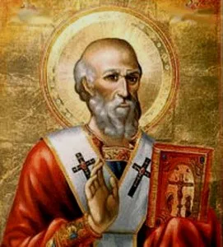
“On the Sabbath day we gathered together, not being infected with Judaism, for we do not lay hold of false sabbaths, but we come on the Sabbath to worship Jesus, the Lord of the Sabbath.”
Athanasius (~366 AD):
Notes:
Athanasius (~366 AD):
Chief Egyptian (Hellenistic, not Coptic) delegate at Nicea and the 20th Bishop of Alexandria, in his writings around 366 AD:

Slide 27
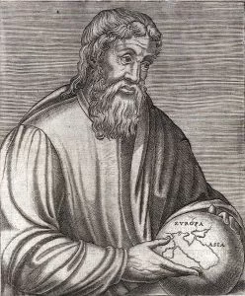
“It is a fact that it was formerly the custom in the East to keep the Sabbath in the same manner as the Lord’s day and to hold sacred assemblies: while on the other hand, the people of the West, contending for the Lord’s day have neglected the celebration of the Sabbath.”
Apollinaris Sidonius (430-489 AD):
Notes:
Apollinaris Sidonius (430-489 AD):
Was a poet, diplomat, and bishop. Sidonius is "the single most important surviving author from fifth-century Gaul.” (present-day France)
First to note a division regarding Sabbath observance between East and West.

Slide 28
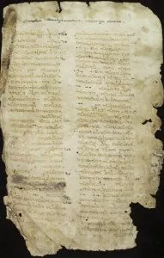
“For although almost all churches throughout the world celebrate the sacred mysteries on the Sabbath of every week, yet the Christians of Alexandria and at Rome, on account of some ancient tradition, have ceased to do this.”
Socrates Scholasticus (380-440 AD):
Notes:
Socrates Scholasticus (380-440 AD):
The 5th-century historian Socrates Scholasticus of Constantinople noted:

Slide 29
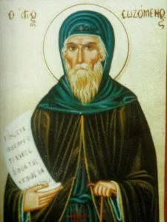
“The people of Constantinople, and almost everywhere, assemble together on the Sabbath, as well as on the first day of the week, which custom is never observed at Rome or at Alexandria.”
Sozomen (400-450 AD):
Notes:
Sozomen:
5th Centuray Christian, Lawyer, and Historian of the Christian Church

Slide 30
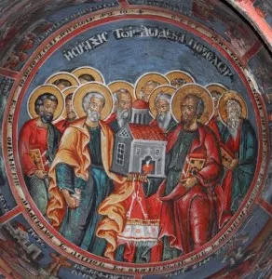
Have before thine eyes the fear of God, and always remember the ten commandments of God, – to love the one and only Lord God with all thy strength; to give no heed to idols, or any other beings, as being lifeless gods, or irrational beings or demons. Consider the manifold workmanship of God, which received its beginning through Christ.
Let the slaves work five days; but on the Sabbath day and the Lord’s day let them have leisure to go to church for instruction in piety. We have said that the Sabbath is on account of the creation, and the Lord’s day, of the resurrection.
Thou shalt observe the Sabbath, on account of Him who ceased from his work of creation, but ceased not from his work of providence: it is a rest for meditation of the law, not for idleness of the hands…
If any one of the clergy be found to fast on the Lord’s day, or on the Sabbath-day, excepting one only [Easter weekend], let him be deprived; but if he be one of the laity, let him be suspended.
Apostolic Constitutions (~150-380 AD):
Notes:
One of the reasons for the East – West split
Constitutions: Christian collection of eight treatises or books
Usually regarded as originating in Syria (between Turkey and Iraq), probably Antioch.
Of the Apostolical Constitutions, Guericke’s Church History says:
“This is a collection of ecclesiastical statutes purporting to be the work of the apostolic age, but in reality formed gradually in the second, third, and fourth centuries, and is of much value in reference to the history of polity, and Christian archaeology generally.” – Ancient Church, p. 212.

Slide 31
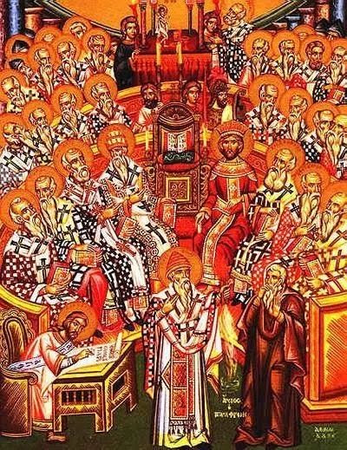
“If any cleric shall be found to fast on a Sunday or Saturday (except on one occasion only [during the Easter Weekend]) he is to be deposed; and if he is a layman he shall be cut off.”
Council of Trullo (692 AD):
Notes:
The Council in Trullo (692 AD)
Entirely an Eastern Council held in Constantinople – not accepted by Roman Catholics
Trullo Council Strongly reacted against the proposed changes of Rome (to include making the weekly Sabbath a day of fasting).
A portion of the Apostolic Constitutions was referenced which said:

Slide 32
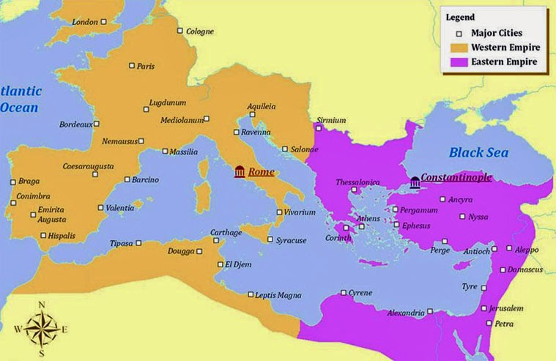
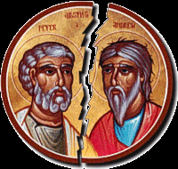
The “Great Schism” Between East and West

Slide 33
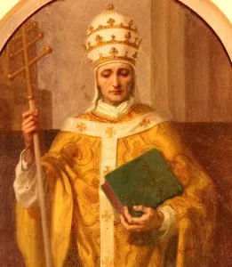
“The Holy See possessed both an earthly and a heavenly imperiam, the royal priesthood… Only the apostolic successor to Peter possesses primacy in the Church.”
However, the Eastern church primarily claimed to be successors of Saint Andrew (the first Apostle) and of Saint John.
Pope Leo IX (1002 – 1054 AD):

Slide 34
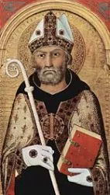
Patriarch Michael Cerularius, in turn, excommunicated the Cardinal and the Pope and subsequently removed the Pope’s name from the diptychs (church records), starting the East-West Schism.
Patriarch Michael Cerularius was offended by the letter brought to him by the legates and responded to the accusations concerning the Sabbath observance by saying: “For we are commanded also to honour the Sabbath equally with the Lord’s [day], and to keep and not to work on it.”
The Great Schism began with an open letter written by the Pope Leo to Patriarch Michael Ceralarius of the Eastern church…
On July 16, 1054, the Sabbath day, when preparations had been made for the liturgy on that day, the three papal legates entered the Church of St. Sophia and laid the bull of excommunication on the altar and walked away, toward Rome, shaking the dust from their feet.
Michael Cerularius (1000-1059):
Notes:
Patriarch Michael Cerularius (1000-1059):
Refused to call Pope Leo “father”
The two biggest issues:
Sabbath not a fast day
Only unleavened bread for Eucharist (communion)
After several written exchanges, Pope Leo IX decided, early in the year of 1054, to send a group of theologians, including Cardinal Humbert to Constantinople.
Cerularius refused to meet with Cardinal Humbert and kept him waiting with no audience for months.
Slides - -
From that day on, the fracture between Constantinople and Rome has never been completely healed. The key problem being that the Eastern churches continued to observe the weekly Sabbath in a way that was much too similar to the way the Jews observed the weekly Sabbath…

Slide 35
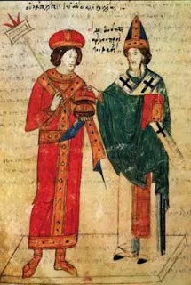
You [Greeks], if you do not Judaize, tell (us) why do you have something in common with the Jews with the similar observance of the Sabbath? They certainly observe the Sabbath, and you observe (it); they dine, and always break the fast, on the Sabbath. In their forty day period they break the fast every Sabbath except one, and you [Greeks] in your forty day period break the fast every Sabbath except one.
“Wherefore, because you observe Sabbath with the Jews and with us Sunday, [the] Lord’s day, you appear by such observance to imitate the sect of the Nazarenes, who in this manner accept Christianity that they might not give up Judaism.”
Cardinal Humbert (1015-1061 AD):
Notes:
In his work, Adversus Calumnis Graecorum (Against the Calumnies of the Greeks), Cardinal Humbert wrote (11th century):
Calumnies: false and slanderous statements

Slide 36
Many Churches Continued to Observe the Sabbath
Eastern and Western

Slide 37
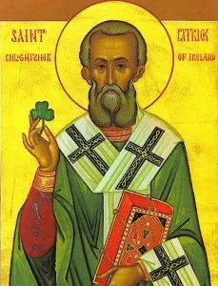
“It seems to have been customary in the Celtic churches of early times, in Ireland as well as Scotland, to keep Saturday, the Jewish Sabbath, as a day of rest from labour. They obeyed the fourth commandment literally upon the seventh day of the week.” – Moffat, p. 140
Ironically St. Patrick himself evidently kept the Saturday Sabbath as a day of rest…
A.C. Flick, The Rise of Medieval Church, pp. 236-327).
St. Patrick
Notes:
6th-7th Century Scotland and Ireland:
Professor James C. Moffat, The Church in Scotland, p. 140

Slide 38
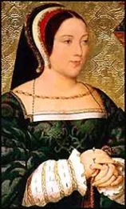
The Scots were Sabbath-keepers up until Queen Margaret…
Queen Margaret (reigned from 1503-1513)
Notes:
The Scots were Sabbath-keepers up until Queen Margaret (reigned from 1503-1513), according to Turgot:

Slide 39
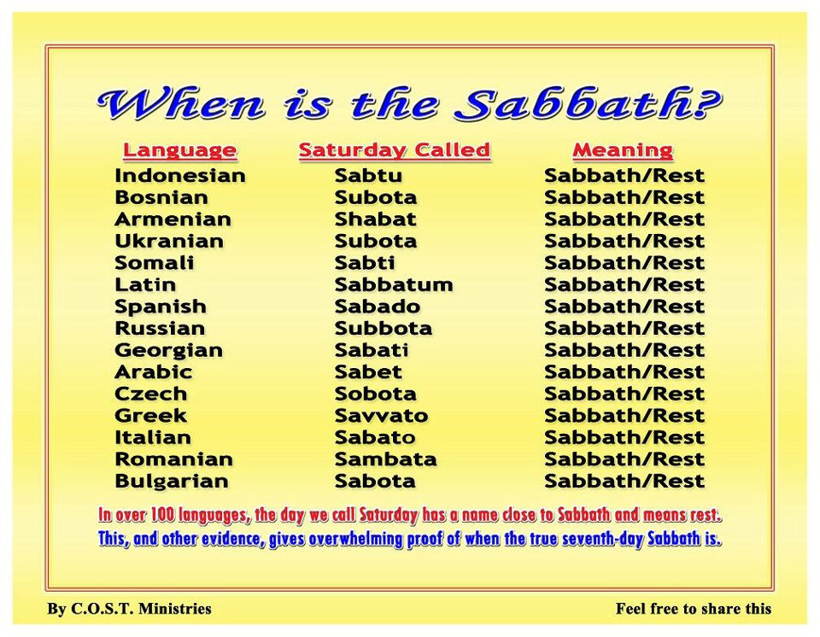
Notes:
Over 100 modern languages call the 7th-day of the week “Sabbath”.

Slide 40
Why Don’t All Christians Observe the Sabbath?

Slide 41
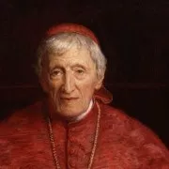
Catholic Church:
“It was the holy Catholic Church that changed the day of rest from Saturday to Sunday, the 1st day of the week. And it not only compelled all to keep Sunday, but at the Council of Laodicea, AD 364, anathematized those who kept the Sabbath and urged all persons to labor on the 7th day under penalty of anathema.”
T. Enright, 1800s
Notes:
The Catholic Church takes full credit for transferring the holiness of the Sabbath day to Sunday.

Slide 42
“The observance of Sunday by the Protestants is an homage they pay, in spite of themselves, to the authority of the [Catholic] Church.”
Louis Gaston Segur, Plain Talk about the Protestantism of To-Day (London: Thomas Richardson and Son, 1874): 213:
“If Protestants would follow the Bible, they should worship God on the Sabbath day by God is Saturday. In keeping the Sunday, they are following a law of the Catholic Church.”
Chancellor Albert Smith for Cardinal of Baltimore Archdiocese, letter dated February 10, 1920:

Slide 43
Orthodox and Eastern Catholics:
“In part, Eastern Christians continue to celebrate Saturday as Sabbath because of its role in the history of salvation: it was on a Saturday that Jesus “rested” in the cave tomb after the Passion. For this reason also, Saturday is a day for general commemoration of the departed, and special requiem hymns are often chanted on this day. Orthodox Christians make time to help the poor and needy as well on this day.”
Wikipedia, Sabbath in Christianity, Eastern Christianity and Saturday vs. Sunday observances (accessed 4/30/17 – Link).
Notes:
Orthodox Christians continue to observe the Sabbath… but it isn’t as prominent today as Sunday observance is.

Slide 44
Protestant / Lutheran:
“We have seen how gradually the impression of the Jewish sabbath faded from the mind of the Christian Church, and how completely the newer thought underlying the observance of the first day took possession of the church. We have seen that the Christians of the first three centuries never confused one with the other, but for a time celebrated both.”
The Sunday Problem, a study book of the United Lutheran Church (1923), p. 36.

Slide 45
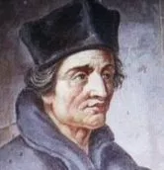
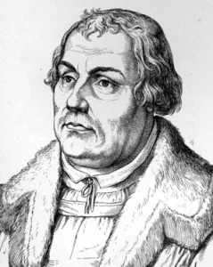
Martin Luther’s final argument was essentially that, “Dr. Eck doesn’t know a thing about Scripture and isn’t willing to listen to a thing about Scripture.“
“If you turn from the church to the Scriptures alone, then you must keep the Sabbath with the Jews, which has been kept since the beginning of the world.” - Dr. John Eck,
Dr. Eck vs. Martin Luther - 1519
Notes:
It is because of Luther’s inconsistency regarding the Sabbath that his claim that Protestantism was based “on the Bible and the Bible only” or “sola scriptura” was successfully challenged during his famous 1519 debate with Dr. John Eck.
Needless to say, Martin Luther lost that debate… in no small part, I believe, because of Luther’s strong personal antisemitism.

Slide 46
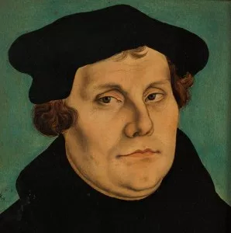
God blessed the Sabbath and sanctified it to Himself. It is moreover to be remarked that God did this to no other creature. God did not sanctify to Himself the heaven nor the earth nor any other creature. But God did sanctify to Himself the seventh day. This was especially designed of God, to cause us to understand that the ‘seventh day’ is to be especially devoted to divine worship….
It follows therefore from this passage, that if Adam had stood in his innocence and had not fallen he would yet have observed the ‘seventh day’ as sanctified, holy and sacred…. Nay, even after the fall he held the ‘seventh day’ sacred; that is, he taught on that day his own family. This is testified by the offerings made by his two sons, Cain and Abel. The Sabbath therefore has, from the beginning of the world, been set apart for the worship of God….
Martin Luther (1483-1546)
Notes:
Luther argued that the Sabbath made by God at the beginning of this world as a gift for Adam and Eve – who then taught it to their own children.

Slide 47
Common Arguments Against Sabbath Observance

Slide 48
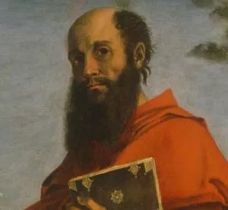
Colossians 2:16-17
“One person considers one day more sacred than another; another considers every day alike. Each of them should be fully convinced in their own mind.”
- Romans 14:5
The law is only a shadow of the good things that are coming--not the realities themselves. For this reason it can never, by the same sacrifices repeated endlessly year after year, make perfect those who draw near to worship.
– Hebrews 10:1
Therefore no one is to act as your judge in regard to food or drink or in respect to a festival or a new moon or a sabbath day— things which are a mere shadow of what is to come; but the substance belongs to Christ.
Notes:
They key phrase is “which are a shadow of things to come”.
The weekly Sabbath is not a shadow of something to come, but is a memorial of a past event – of creation week. The other ceremonial laws, including animal sacrifices and sabbaths, pointing forward to the life and death of Jesus, were indeed “shadows” of things to come and were fulfilled when they met their reality in Christ.

Slide 49
The commandments, “You shall not commit adultery,” “You shall not murder,” “You shall not steal,” “You shall not covet,” and whatever other command there may be, are summed up in this one command: “Love your neighbor as yourself.”
– Romans 13:9
Notes:
Therefore, it is argued by anti-Sabbatarians, the Sabbath is no longer an obligation for the Christian who lives by God’s grace and faith the victory of Christ on our behalf… according to the “New Covenant” of grace set up by Jesus at the time of His death and resurrection.
Of course, when challenged on this position, most will agree that it is still wrong to murder, steal, commit adultery, covet, etc… In fact, most will agree that nine of the ten commandments of the Decalogue are still binding.

Slide 50
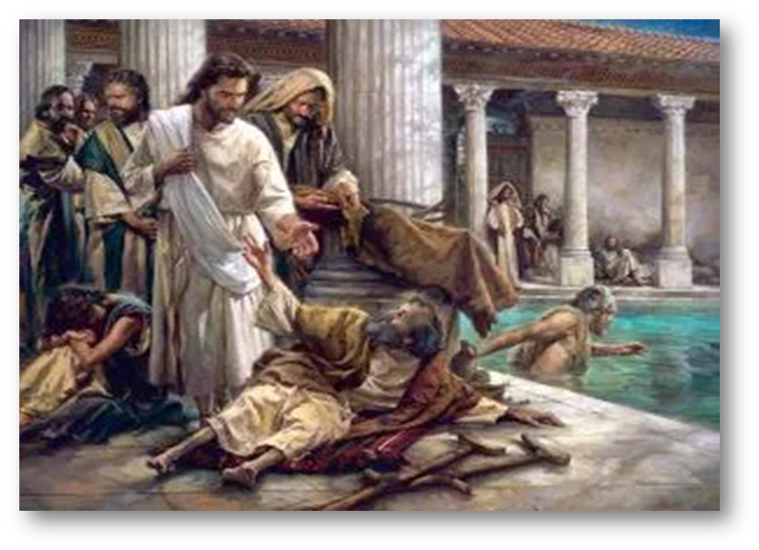
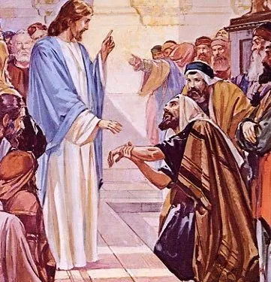
Jesus broke the Sabbath to do away with it…
Then he said to them, “The Sabbath was made for man, not man for the Sabbath.
– Mark 2:27
“You hypocrites!” the Lord replied, “Does not each of you on the Sabbath untie his ox or donkey from the stall and lead it to water?
– Luke 13:15
Then he asked them, “If one of you has a child or an ox that falls into a well on the Sabbath day, will you not immediately pull it out?”
– Luke 14:15
And He asked them, “Which is lawful on the Sabbath: to do good or to do evil, to save life or to destroy it?” But they were silent.
– Mark 3:4 and Luke 6:9
How much more valuable is a person than a sheep! Therefore it is lawful to do good on the Sabbath.
– Matthew 12:12
So Jesus asked the experts in the law and the Pharisees, “Is it lawful to heal on the Sabbath or not?” But they remained silent.
– Luke 14:4
Or haven’t you read in the Law that the priests on Sabbath duty in the temple desecrate the Sabbath and yet are innocent?
– Matthew 12:5

Slide 51
Every day should be treated like a Sabbath:
Sabbath intended as a special time with God, free of secular pursuits and labor
Why a particular day of the week? Isn’t that arbitrary for God to ask?
Yes!
Seven day cycle, with a day of rest once a week, shown to be physically beneficial
No empirical reason to select one specific day – only that God said so.
Similar to the test given to Adam and Eve or Cain and Abel

Slide 52
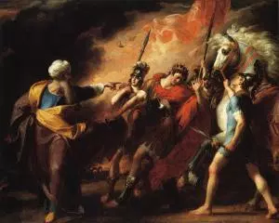
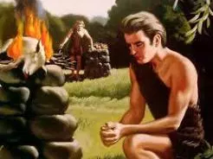
“To obey is better than sacrifice, and to heed is better than the fat of rams.”
- 1 Samuel 15:22

Slide 53
Sabbath Given Only to the Jews:
The 4th Commandment cites the creation week of Genesis as the reason for Sabbath
Jesus says that He created the Sabbath for all of mankind (anthropos) – Mark 2:27
The Talmud and Midrash argue that the Sabbath existed before Moses – that Abraham and the patriarchs observed the Sabbath
Philo (20-60 AD): Sabbath universal
Martin Luther: Sabbath created in Eden
Part of universal Moral Code within Ark of Cov

Slide 54
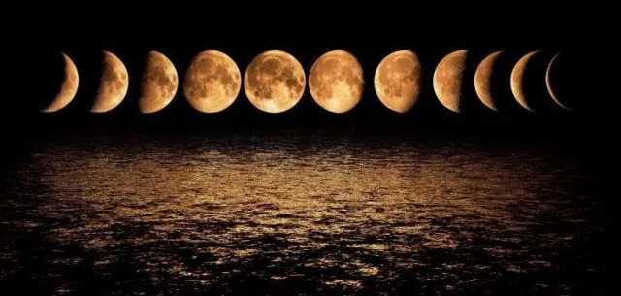

Slide 55
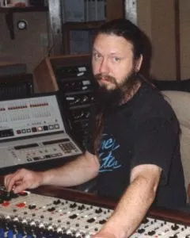
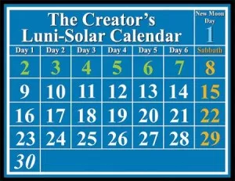
Notes:
Started with the record producer and audio engineer Jonathan David Brown who is credited with being the first lunar sabbath keeper in this century
Brown published the book Keeping Yahweh’s Appointments in 1998
An anti-Semite who was convicted for his connection to a 1990 Synagogue shooting.

Slide 56
The ancient Assyrians and Babylonians did regularly observe specific days of certain months of the year (the 13th month of Elul II and the 8th month of Marcheshvan) as being special days where no work was done – in honor of the moon god “Sin”.
Notes:
Since twelve lunar months are approximately eleven days shorter than the solar year, the Babylonian calendar was intercalated (or evened out) every two or three years by the addition of a 13th month – the month of Elul II. During these special months the 7th, 14th, 19th, 21st and 28th days were known as “evil days” that were unlucky days unless the gods were appeased by acts of devotion…

Slide 57
Which Came First?
The question is, then, which came first? Did the concept of a seven-day week, and the Sabbath idea, really begin with the ancient Sumerians who then passed the idea on to the Babylonians who then passed it on to the Jews? Or, was it the other way around?

Slide 58
“At first glance, it might seem that weekly rhythms developed in response to the seven day week imposed by human culture thousands of years ago. However, this theory doesn’t hold once you realize that plants, insects, and animals other than humans also have weekly cycles. . . . Biology, therefore, not culture, is probably at the source of our seven day week.”
Susan Perry and Jim Dawson, The Secrets Our Body Clocks Reveal, (New York: Rawson Associates, 1988), pp. 20-21
Biorhythms and the origin of the 7-day week
Notes:
Practically every living thing has within itself a biological clock that is “tuned” to a seven-day cycle or “biorhythm” known as a “circaseptan” rhythm. Secular scientists find it difficult to explain how such a seven-day cyclical pattern would arise or evolve in living things by any natural means.

Slide 59
Fear God and give him glory, because the hour of his judgment has come. Worship him who made the heavens, the earth, the sea and the springs of water. – Revelation 14:7
For in six days the LORD made the heavens and the earth, the sea, and all that is in them, but he rested on the seventh day. Therefore the LORD blessed the Sabbath day and made it holy. – Exodus 20:11

Slide 60
Much much more at:
EducateTruth.com
/featured/christians-and-the-sabbath/

Slide 61
Title: Christians and the Sabbath
Text: Exodus 20:8-11
Closing Song: O Day of Rest and Gladness – p. 382

